Slide 1
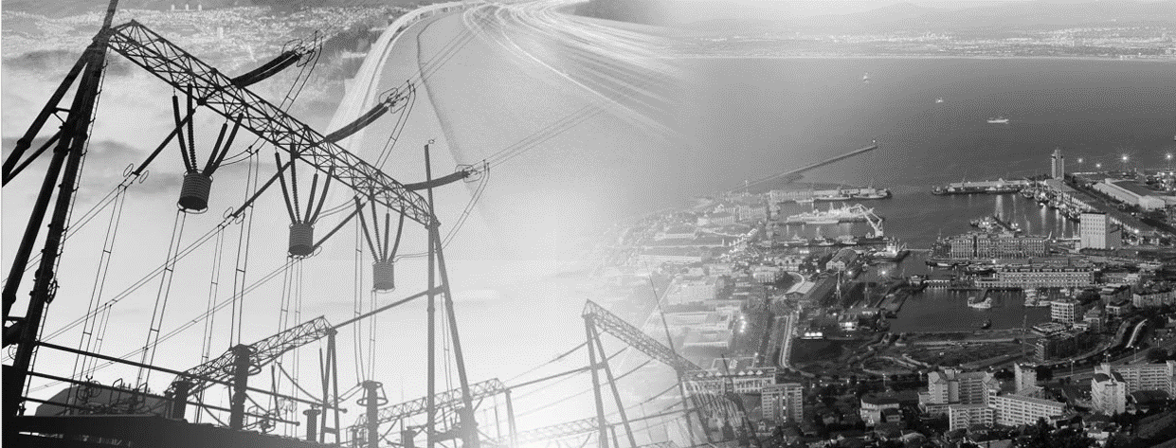
INVITATION
YOU ARE CORDIALLY INVITED TO OUR SARWA COP RIGHT OF WAY TRAINING SESSION ON 13-14 SEPTEMBER 2017.
EACH COMMUNITY OF PRACTICE WILL HAVE A DEDICATED ROOM WITH A LINE-UP INCLUDING EXTREMELY INTERESTING PRESENTATIONS AND CASE STUDIES. VERY WELL KNOWN LOCAL AS WELL AS INTERNATIONAL SPEAKERS WILL SHARE THEIR KNOWLEDGE ON RIGHT OF WAY RELATING TO THE SOUTH AFRICAN ENVIRONMENT.
(NOT TO BE MISSED)

Slide 2
INFO ON PROPOSED SPEAKERS
Speakers include:-
The panel chairman of the 1st world congress on infrastructure asset management
Individuals pivotal in NERSA requirement alignment with mSCOA and CIDMS
The authors of the Cities Infrastructure and Delivery Management system funded by National Treasury
Land specialists from private and public sector indicating how you account for land associated with your infrastructure in Asset registers

Slide 3
PROGRAM – DAY 1
DAY 1 | Conference Venue
 | All members
 | ALL COP’S
8:15 - 8:45 | Registration
8:45 - 9:00 | Opening / Welcome / Purpose
9:00 - 10:00 | Overview of Asset Management (Erina Otto)
10:00 - 11:00 | Valuers Overview (Lourens Nel)
11:00 - 11:30 | Tea break
11:30 - 13:00 | IFC Performance Standards (Kentridge Makhanya)
13:00 - 14:00 | Lunch
14:00 - 15:00 | Reality Modelling of the Built Environment using latest Survey and Spatial Tools (Brett Forbes)
15:00 - 16:00 | Overview on Negotiation (Daan Mostert)

Slide 4
PROGRAM – DAY 2
DAY 2 | Venue 1
 | 20-30 seater
 | ASSET MANAGEMENT
8:30 - 9:00 | Registration
9:00 – 10:00 | Tools and techniques to improved Right of Way Asset Management (Louis Boshoff)
10:00 – 11:00 | Right of way & NERSA alignment (Rofhiwa Khaukhni)
11:00 - 11:30 | Tea break
11:30 - 13:00 | The impact of town planning on right of way (Werner Fourie)
13:00 - 14:00 | Lunch
14:00 - 15:00 | Tips on asset audits (case study) (Rofhiwa Khaukhni)
15:00 - 16:00 | Wrap up – software demo’s by various firms and draw for the grand prize!!
DAY 2 | Venue 2
 | 20-30 seater
 | VALUATION
8:30 - 9:00 | Registration
9:00 – 10:00 | Servitudes and effect on Market Value (Adele Locker)
10:00 – 11:00 | Case Study Discussion (Adele Locker)
11:00 - 11:30 | Tea break
11:30 - 13:00 | Strip Valuation – Case Study (Lourens Nel)
13:00 - 14:00 | Lunch
14:00 - 15:00 | Unusual servitudes – Case study (Adele Locker)
15:00 - 16:00 | Wrap up

Slide 5
PROGRAM – DAY 2
DAY 2 | Venue 3
 | 20-30 seater
 | ENVIRONMENTAL AND RELOCATIONS
8:30 - 9:00 | Registration
9:00 – 10:00 | Community unrest and protest against construction projects (Tshinnane Mutshatshi)
10:00 – 11:00 | Challenges with EIA Reports, Packaging and Scope (Mahlatse Shubane)
11:00 - 11:30 | Tea break
11:30 - 13:00 | Opportunities and Threats in Consulting Industry (Bharat Gordhan)
13:00 - 14:00 | Lunch
14:00 - 15:00 | Resettlement Process in Land Acquisition (Karien Lotter)
15:00 - 16:00 | Wrap up
DAY 2 | Venue 4
 | 20-30 seater
 | SURVEYING
8:30 - 9:00 | Registration
9:00 – 10:00 | Overview of Survey Landscape within various Utilities (Sanjeev Hirachund)
10:00 – 11:00 | Overview of Survey Landscape within various Utilities (Busi Nkosi)
11:00 - 11:30 | Tea break
11:30 - 13:00 | Overview of Survey Landscape within various Utilities (Sasol)
13:00 - 14:00 | Lunch
14:00 - 15:00 | Processing of Mobile Lidar Data using Terrasolid Software (Maipfi Nudzungani)
15:00 - 16:00 | Field demo
DAY 2 | Venue 5
 | 20-30 seater
 | NEGOTIATIONS
8:30 - 9:00 | Registration
9:00 – 10:00 | Tool and Techniques in Negotiating (Daan Mostert)
10:00 – 11:00 | PAJA process (Daan Mostert)
11:00 - 11:30 | Tea break
11:30 - 13:00 | Negotiation Case Study (Daan Mostert)
13:00 - 14:00 | Lunch
14:00 - 15:00 | Negotiate to compensate (Daan Mostert)
15:00 - 16:00 | Wrap up

